Slide 1
Go to meeting
By: Ananta, Shahzar, Ralph

Slide 2
What is GTM?
GoToMeeting is a web-hosted service created and marketed by the online services division of Citrix Systems. It is an online meeting, desktop sharing, and video conferencing software that enables the user to meet with other computer users, customers, clients or colleagues via the Internet in real time

Slide 3
Why GTM?
Integrated phone and VoIP
Video quality
Video format
Audio controls
Save the chat log
Screen share
Encryption
Multiple access

Slide 4
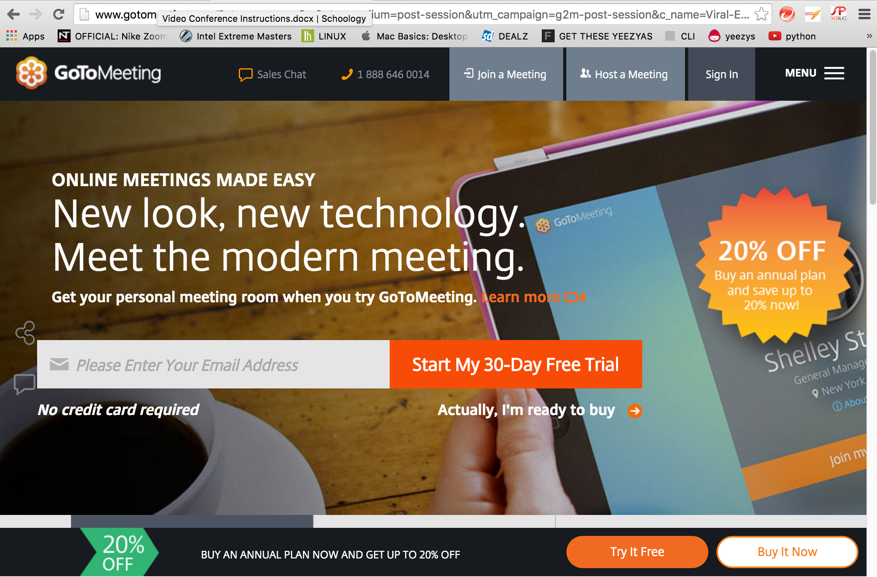
How to get gtm
www.gotomeeting.com
Sign Up with name and email

Slide 5
Requirements
Internet connection and device
Input and output for audio and video
Set up takes 5 minutes
5 minutes to learn how to use
Same on PC and MAC
Difference in GUI when used on phone

Slide 6
Benefits
Scheduling
Lower Costs
Easy to set up
Able to conference with multiple people
As long as 8 hours
Options, adding password
Can share screen, video, or voice call
Schedule meeting times with built in agenda
30 day trial

Slide 7
Business use
Multiple users
Teachers
Presentations
Be there with out being there
Demo
Virtual meetings

Slide 8
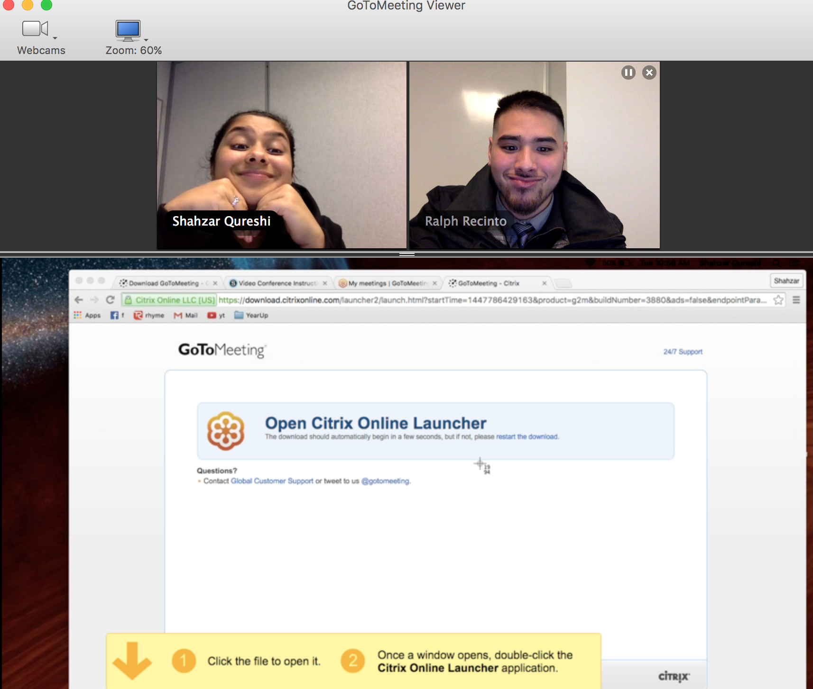

Slide 9
Issues and challenges
Take 5 minutes to get used to
Not user friendly
Not 100% free
After the trial cost 24$ per month/up to 5 people
39$ PRO plan/Small to Medium/up to 25 people
49$ PLUS plan/Large companies/up to 100 people

